Slide 1
Stereo Matching in a Nutshell
Chi Zhang, joint PhD candidate between Sun Yat-Sen University and Microsoft Research Asia

Slide 2
How do human perceive depth?
Single-eye (Depth prediction from single image)
Use scene priors (occlusion, focus, haze, vanishing lines ...).
Mainly rely on learning-based methods.
Accuracy: low.
Two-eye (The Stereo Matching problem)
Use two-view geometry.
Mainly rely on triangulation between correspondences.
Accuracy: high.

Slide 3
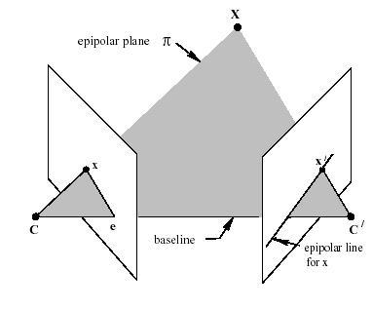
How does two-eye geometry work?
Assume poses of the two eyes are known:
We can compute its two projections from a 3D point.
We can recover a 3D point from its two projections by triangulation.
3D point computation reduces to correspondence search.
All possible correspondences of a projection in one view lie in a same line (the epipolar line) in the other view.

Slide 4
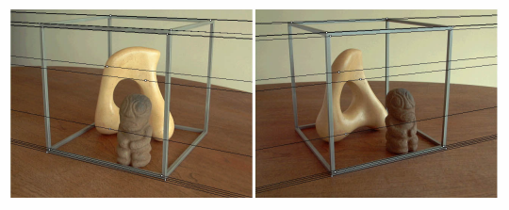
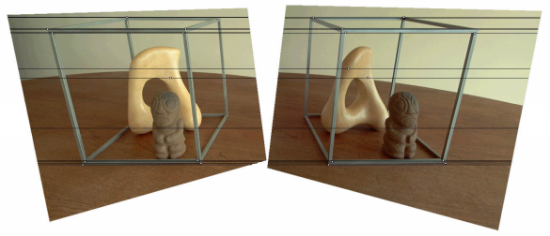
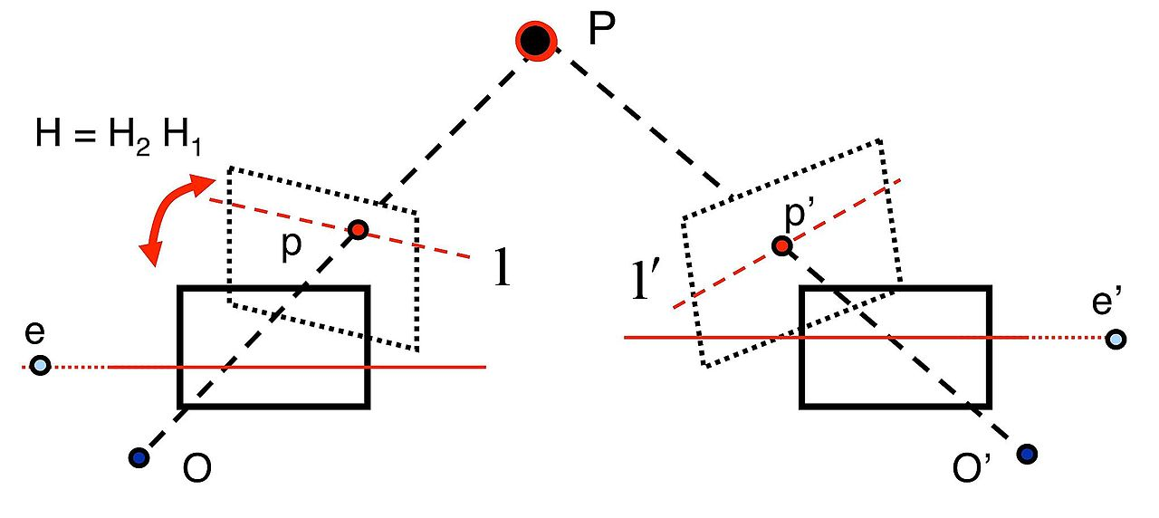
Image Rectification
Depth estimation reduces to correspondence search along epipolar line.
Image rectification makes epipolar lines parallel, after which correspondence search reduces to simpler 1D search on scanline.

Slide 5
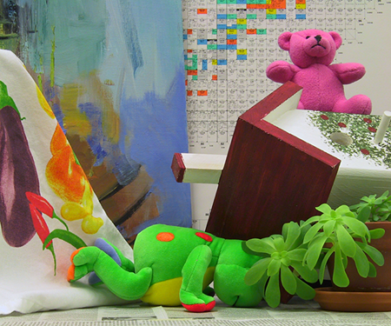
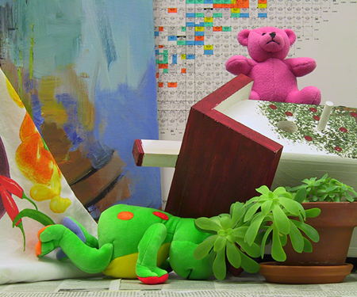
Stereo Matching – Problem Definition
Left Image
When the two cameras are coplanar and aligned w.r.t. their baseline, epipolar lines become parallel to the x-axis.
Correspondence search becomes a 1D search (along the x-axis).
This enables huge simplification for matching algorithms.
Stereo Rectification can bring all correspondences into a same horizontal line (It is considered a solved problem).
Each correspondence pair is recorded as a disparity.
Right Image

Slide 6
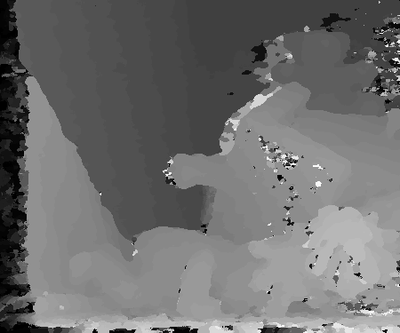
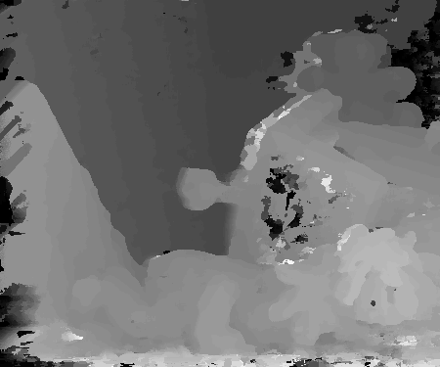
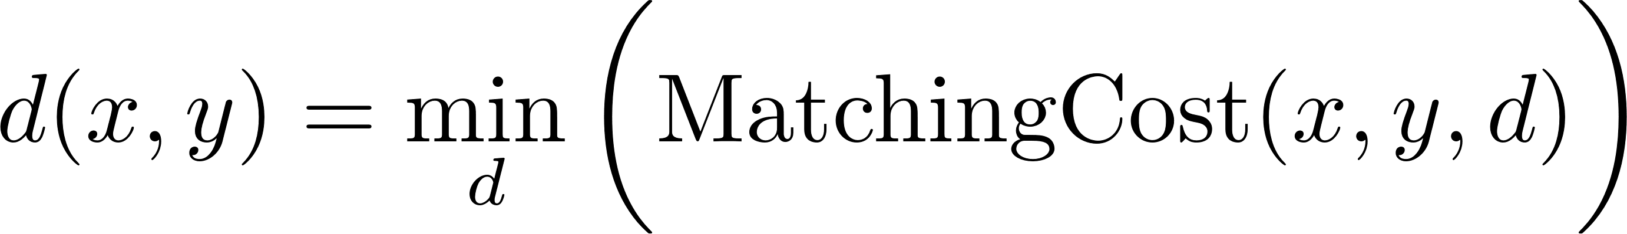
How do we match correspondences?
A naïve solution:
For each pixel (patch), enumerate all possible target pixel (patch) in the same horizontal line, and retain the most similar patch.
i.e. Search for the disparity which gives the lowest matching cost (Winner-Takes-All, WTA):
Matching cost defined as the distance between local features.
Results are noisy
WTA using Census
WTA using Colors

Slide 7

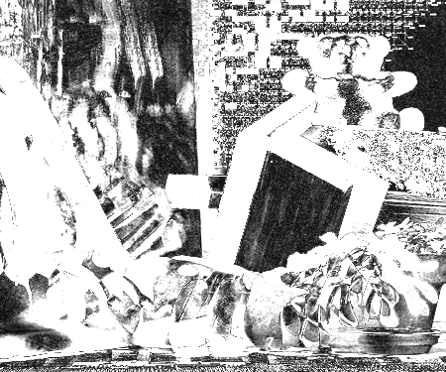
Why is simple WTA scheme noisy? (Visualizing the matching cost volume)
Two reasons:
Local descriptors not distinctive enough.
Pixels being occluded have no matches by definition.
Solutions:
Improve descriptors’ distinctiveness.
Impose prior knowledge (e.g. spatial regularization).
x
d
y

Slide 8
Existing stereo methods
Papers focusing on improving the stereo matching cost:
Adaptive Support weights (Yoon and Kweon, CVPR’05)
PatchMatch Stereo (Bleyer et al., BMVC’11)
MC-CNN (Zbontar and LeCun, CVPR’15)
…
Papers focusing on imposing various regularizations:
Typical 4-neighborhood MRF (Kolmogorov and Zabih, ECCV’02; Sun et al., ECCV’02)
SGM (Hirschmuller, CVPR’05)
2nd order smoothness prior (Woodford et al., CVPR’08)
Segment-based plane fitting (Klaus et al., ICPR’06)
…

Slide 9
Enhancing Matching Cost

Slide 10
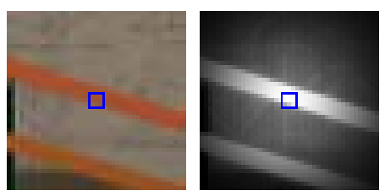
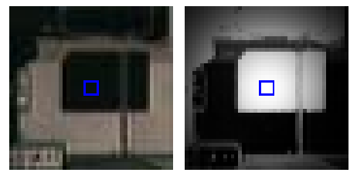
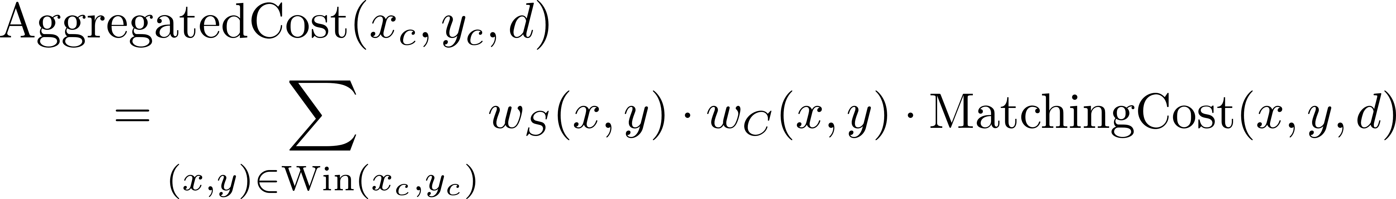
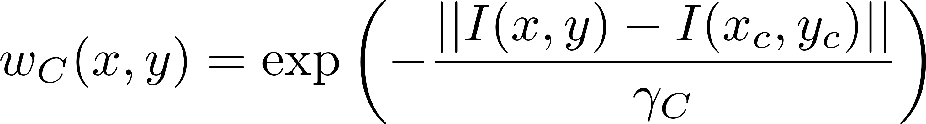
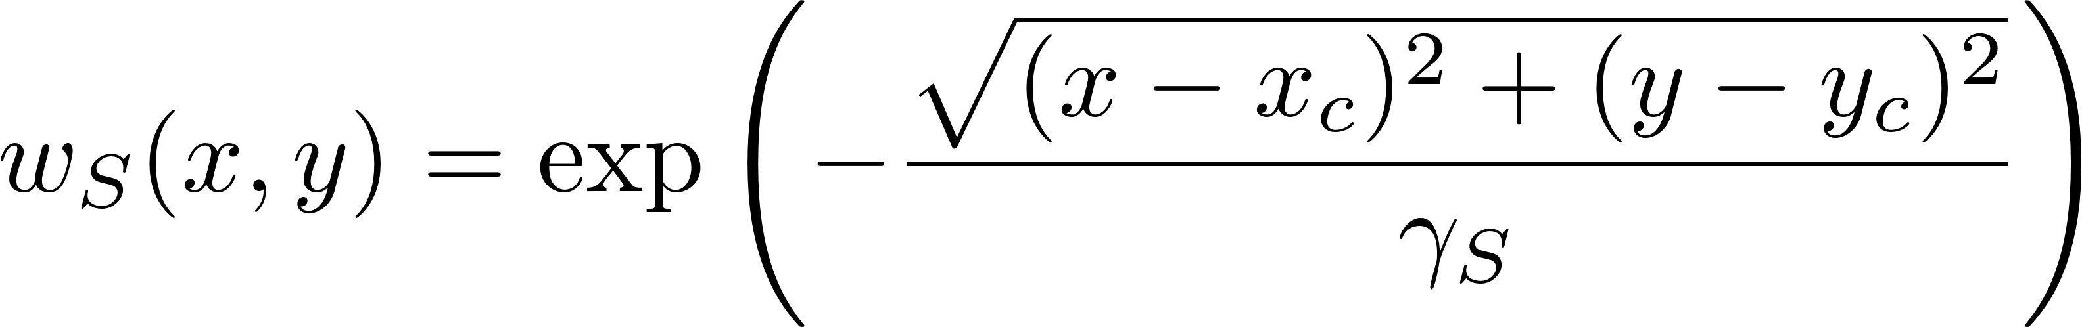
Adaptive Support Weights (ASW) (Yoon and Kweon, CVPR’05) [1]
Key ideas:
Compute matching cost at a larger window (i.e. 35x35)
Pixels closer and more similar to the center pixel contribute more to the cost (ADAPTIVE)
Pros and Cons:
Adaptive weights is more reasonable than fixed weights.
Slow.
Color patch
weights

Slide 11
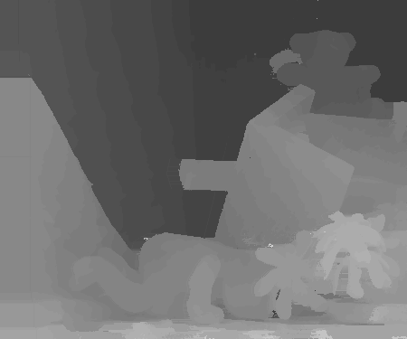
Adaptive Support Weights (ASW) (Results)

Slide 12
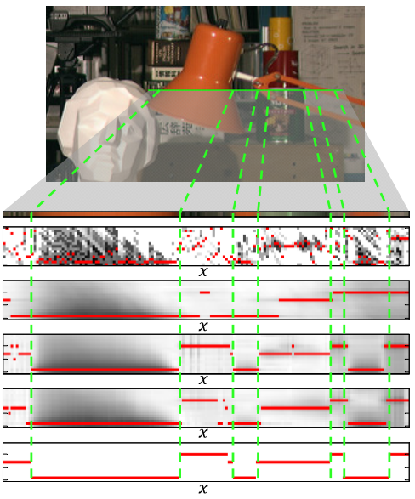
Fast Cost Volume Filtering (Rhemann et al., CVPR’11) [2]
Key ideas:
Computing matching cost by ASW is equivalent to filtering each z-slice of the cost volume by a bilateral filter.
Accelerate the filtering process by using Guided Filter.
Raw Costs
Box Filter
Bilateral Filter
Guided Filter
Ground Truth

Slide 13
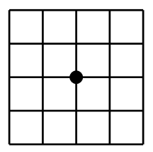
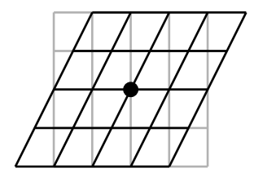
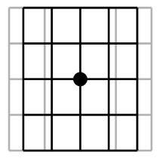
PatchMatch Stereo (Bleyer et al., BMVC’11) [3]
Disparity patch
Matching window
shape
Motivation:
Matching costs computed by matching square windows have “frontal-parallel” bias.
Key ideas:
Parameterize each pixel as a plane instead of a disparity value.
Matching window is now square-to-trapezoidal.
Problem:
Variables have too many states (infinite numbers of possible planes).
Solution:
Inference by PatchMatch algorithm!
An example constant patch
An example y-slanted patch
An example x-slanted patch

Slide 14
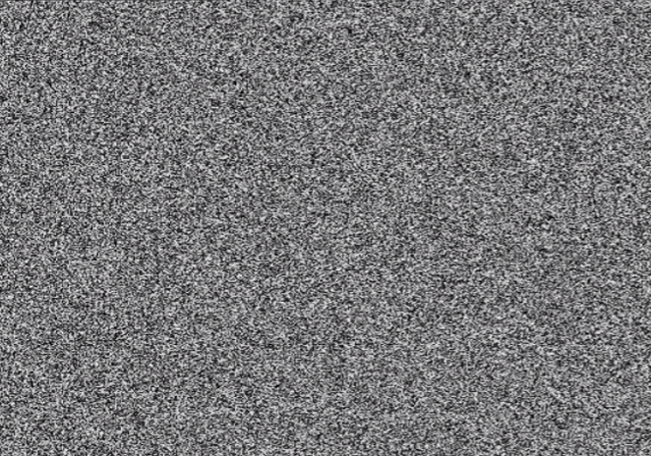
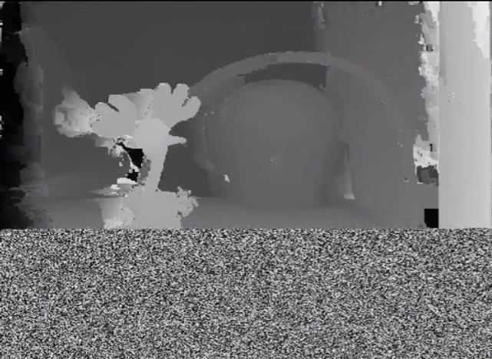
PatchMatch Stereo
Three secret ingredients (repeat step 2, 3 till convergence):
Random Initialization
Initialize disparity planes for each pixel randomly.
There’re always some pixels which get “good” planes simply by chance.
Spatial Propagation
A pixel will try the current best planes from its neighbors.
Neighboring pixels often share a same/similar plane.
Good planes will “travel” very fast across the image.
Random Refinement
Perturb the current best plane in an exponentially decreasing radius.
Help enrich proposals, and help escape from local minimum.
Random Initialization
During 1st iteration

Slide 15
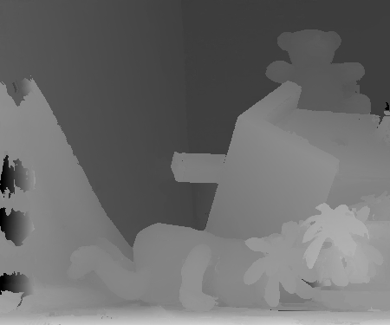
PatchMatch Stereo (Results)

Slide 16
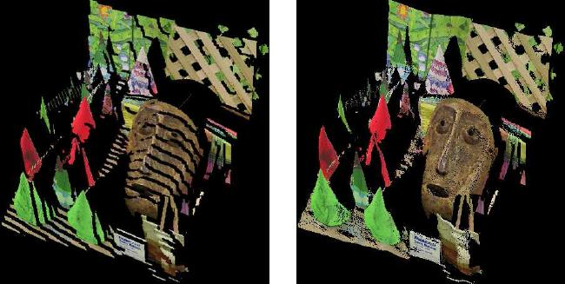
PatchMatch Stereo
Comparison between ASW and PMS (point clouds).
Add point cloud to justify slanted plane matching cost
Adaptive Support Weights
Square Window
PatchMatch Stereo
Slanted Window

Slide 17
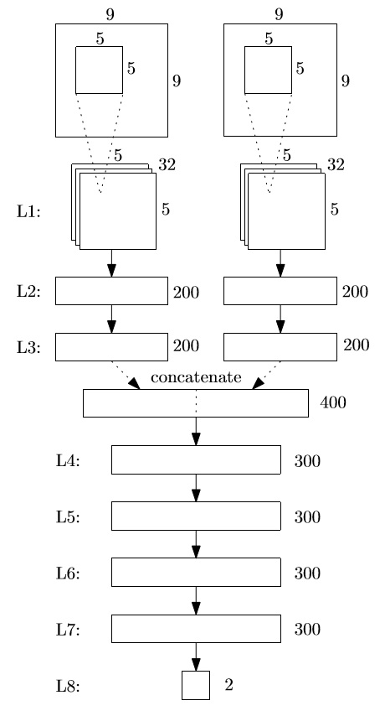
Training Matching Cost by CNN (Zbontar and LeCun, CVPR’15) [4]
Key Ideas:
Compute matching cost by CNN instead of using hand-crafted features and distance measure.
Network work input is two raw patches, output is their similarity score.
Pros and Cons:
Very robust.
Slow.

Slide 18
Imposing Spatial Regularizations

Slide 19
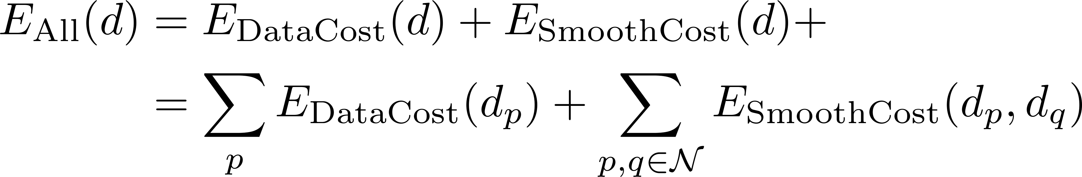
Classic 4-Neighbor MRF Formulation
Objective function:
The problem is NP-hard.
Solvers (all approximated):
Graph Cut.
Belief Propagation.
Dynamic Programming.
Semi-Global Matching.
Variational Solver.
Pixel, where matching cost
is defined.
Neighborhood, where
smoothness cost is defined.

Slide 20
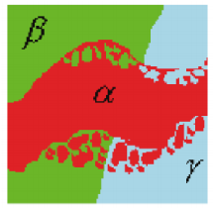
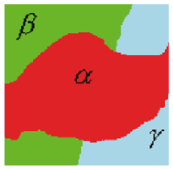
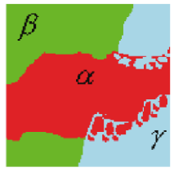

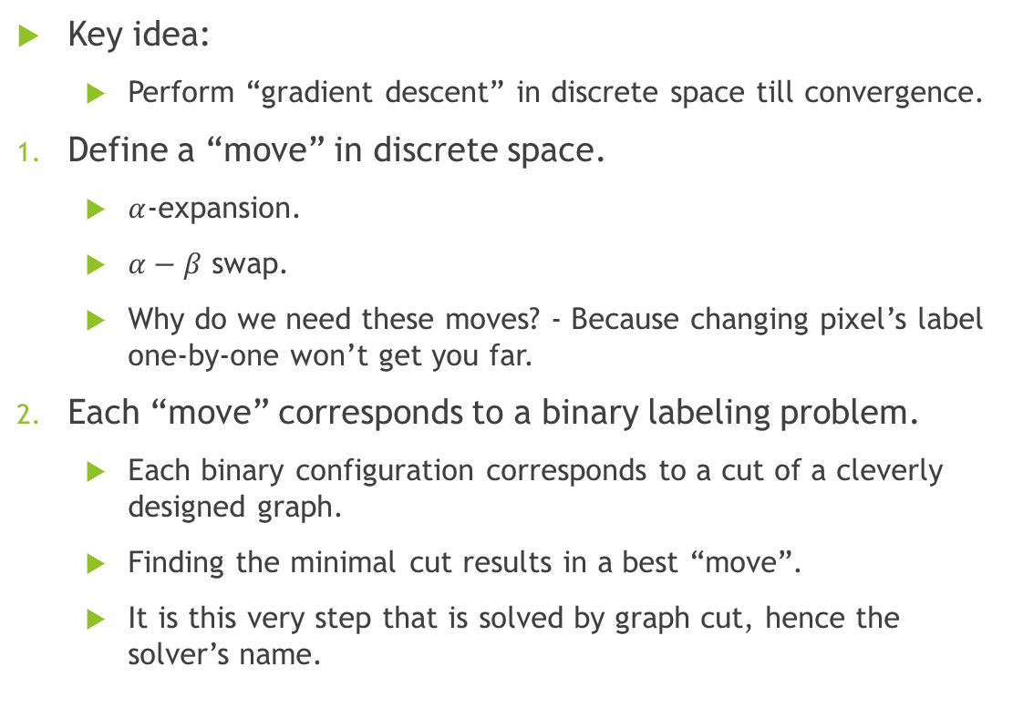

The Graph Cut Solver (Boykov et al., PAMI’01) [5]
Key idea:
Perform “gradient descent” in discrete space till convergence.
Define a “move” in discrete space.
$α$-expansion.
$α−β$ swap.
Why do we need these moves? - Because changing pixel’s label one-by-one won’t get you far.
Each “move” corresponds to a binary labeling problem.
Each binary configuration corresponds to a cut of a cleverly designed graph.
Finding the minimal cut results in a best “move”.
It is this very step that is solved by graph cut, hence the solver’s name.
One possible $α$-expansion move
One possible $α−β$ swap move

Slide 21
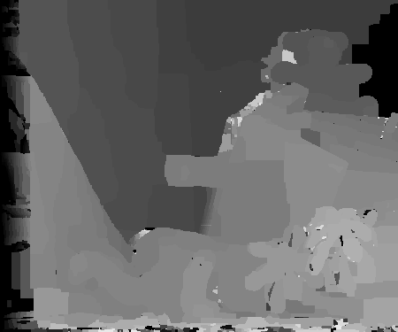
The Graph Cut Solver (Results)

Slide 22
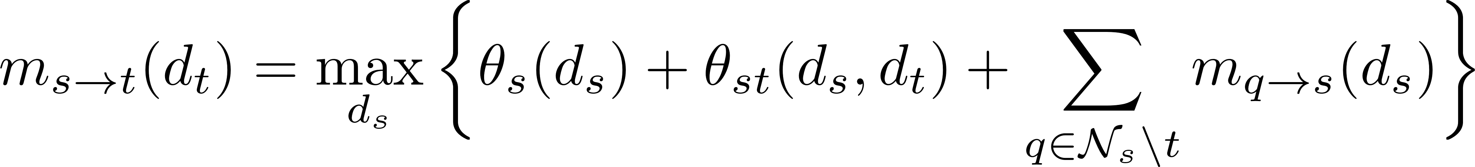
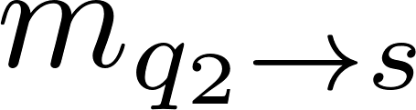
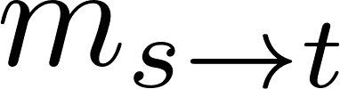
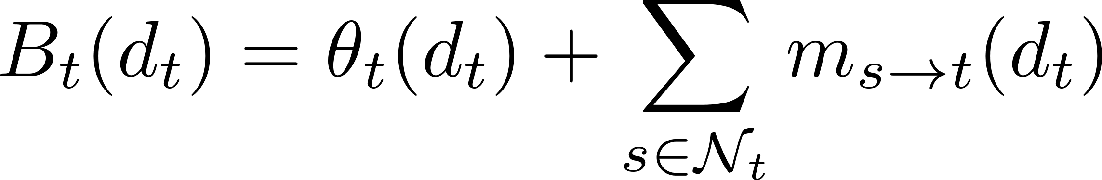
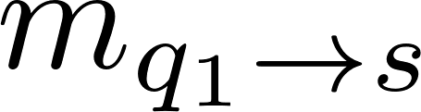
The Belief Propagation Solver (Sun et al., ECCV’02) [6]
Key ideas:
Each candidate disparity receives endorsements (messages) from neighboring pixels.
The endorsement (message) is defined recursively to propagate info globally.
The disparity with largest combined endorsements and self-confidence, wins.
Algorithm:
Initialize all messages to zero.
Update messages until convergence.
q₁
Message:
s
t
Belief:
q₂

Slide 23
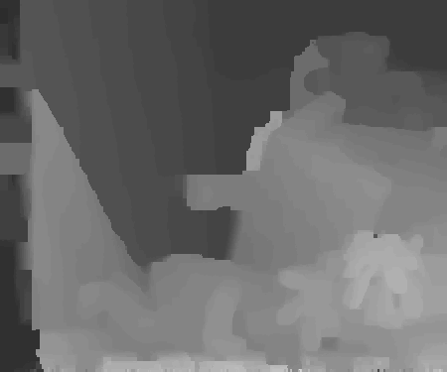
The Belief Propagation Solver (Results)

Slide 24
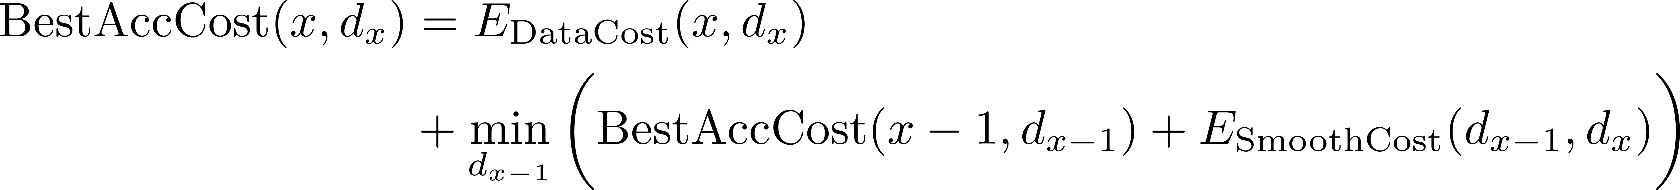
The Dynamic Programming Solver (Bobick and Intille, IJCV’99) [7]
Key ideas:
Consider only left and right adjacent pixels as neighbors.
Problem difficulty drastically reduced under this assumption: global minimum reachable efficiently.
Algorithm:
Solve each line independently by dynamic programming:
Pros and Cons:
Very fast, solution is globally minimal.
Results are of low quality, have streaking artifacts.
Pixel, where matching cost
is defined.
neighborhood, where
smoothness cost is define.
Removed neighborhood.

Slide 25
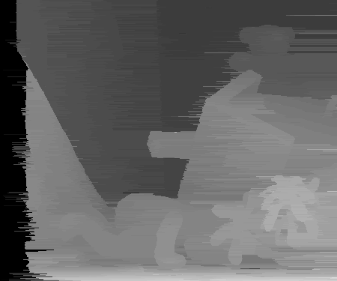
The Dynamic Programming Solver (Results)

Slide 26
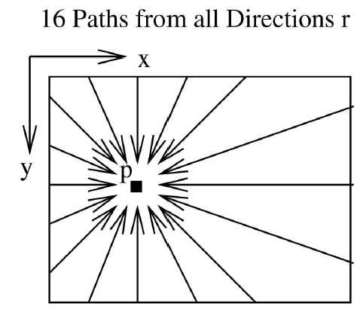

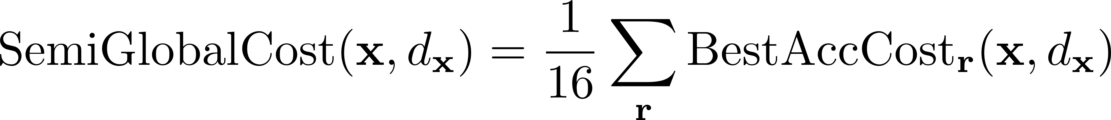
The Semi-Global Matching Solver (Hirschmuller, CVPR’05) [8]
Key ideas:
Fuse results from the dynamic programming solver at 16 directions.
Fuse the 16 results into matching costs, instead of directly into disparity maps.
Algorithm:
Since we’re aggregating cumulated costs, longer paths with large costs may dominate the contributions, biasing towards favoring results from the longer paths.
Solution: subtract the minimum from last pixel.

Slide 27
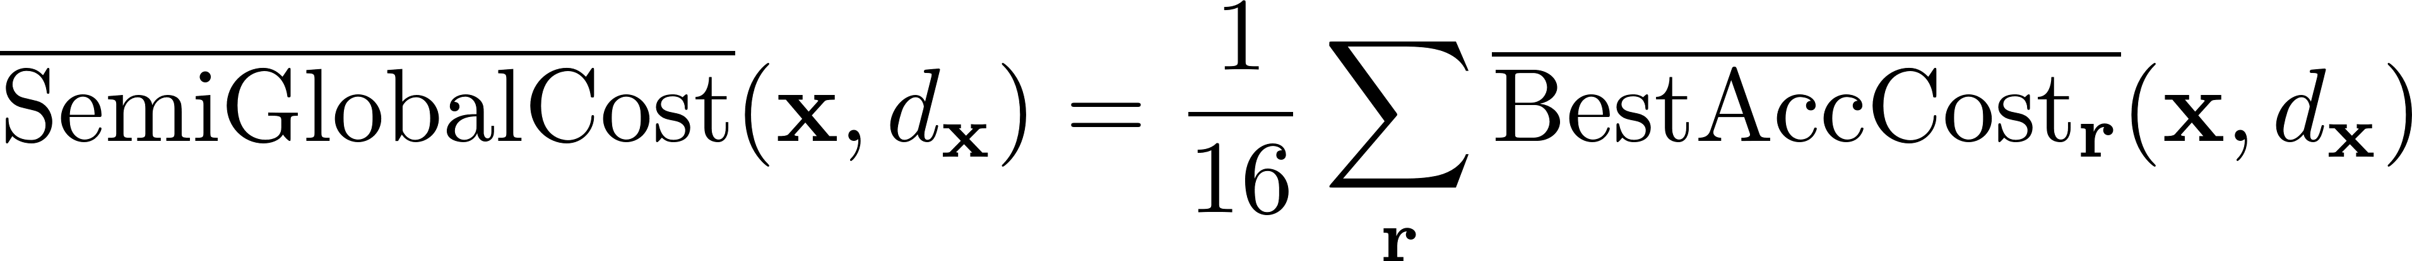
The Semi-Global Matching Solver
Algorithm:
Since we’re aggregating cumulated costs, longer paths with large costs may dominate the contributions, biasing towards favoring results from the longer paths.
Solution: subtract the minimum from last pixel:
……
Example path types.

Slide 28
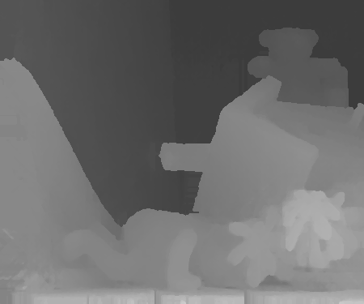
The Semi-Global Matching Solver (Results)

Slide 29
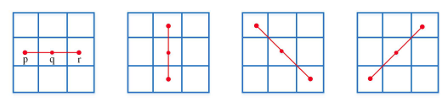
2nd-Order Smoothness On Triplets (Woodford et al., CVPR’08) [9]
Key ideas:
Penalize non-co-linearity instead of non-equality.
Define smoothness on triplets instead of pairs.
Energy is NOT submodular, solve under a “QPBO + proposal generation” framework.
New energy:
Algorithm:
Repeat the followings until convergence:
Generate disparity map proposals.
Fuse the proposal with the current disparity map by QPBO.
(4 types of triplets)

Slide 30
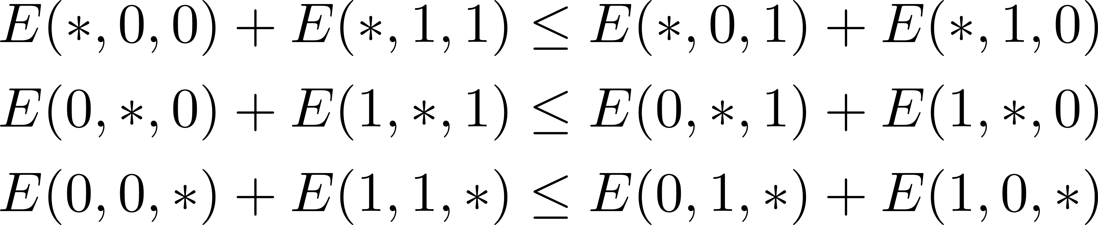
Quadratic Pseudo-Boolean Optimization (QPBO) (Kolmogorov and Rother, PAMI’07) [10]
What is QPBO?
It’s an algorithm to minimize a binary labeling problem on a non-submodular graph.
Graph cut v.s. QPBO:
Graph cut requires the energy to be submodular, QPBO does not.
Graph cut outputs a global minimal labeling.
QPBO outputs a partial labeling, where:
The labeled pixels are at the values they would have at the global minimum.
The unlabeled pixels, if all remain unchanged, will guarantee a decrease of the energy.
Definition of Submodularity:
Unary terms are submodular by default.
Pairwise terms must satisfy:
Ternary terms must satisfy:
An energy is submodular if all its terms are submodular.

Slide 31
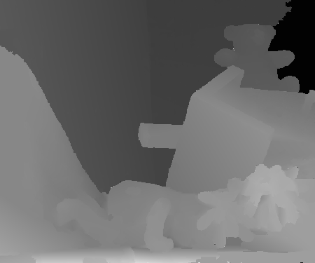
2nd-Order Smoothness On Triplets (Results)

Slide 32
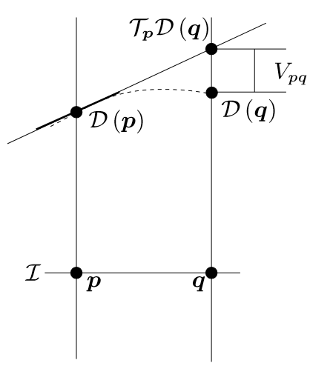
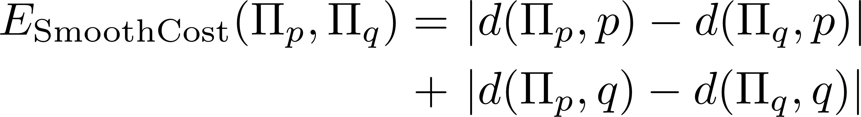
2nd-Order Smoothness On 3D-Label Pairs (Olsson et al., CVPR’13) [11]
Key idea:
Enforce 2nd order smoothness on 3D-label (disparity plane) pairs, instead of on disparity triplets.
New smoothness:
Imposed on neighboring disparity planes.
Algorithm:
Repeat the following until convergence:
Generate disparity plane proposals.
Fuse the current estimate with the proposal using QPBO.
Illustration of 2nd-order smoothness cost over 3D-label pairs.

Slide 33
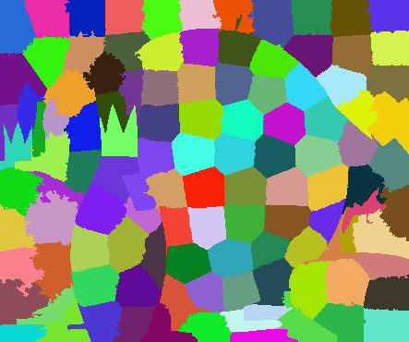

Segment-Based Plane Fitting (Klaus et al., ICPR’06) [12]
Key ideas:
Fit a disparity to each pre-segmented region.
Implicitly assume each region is planar.
Algorithm:
Segment the color image into superpixels by SLIC, Mean-shift, etc.
Initialize a noisy disparity map by Winner-Takes-All (WTA).
Fit a disparity plane to each region using RANSAC.
Pros and Cons:
Robust to noise.
Regularization (planar assumption) too strong for many cases (e.g. Bowling).
Rely heavily on the quality of segmentation.
SLIC segmentation
Mean-Shift segmentation

Slide 34
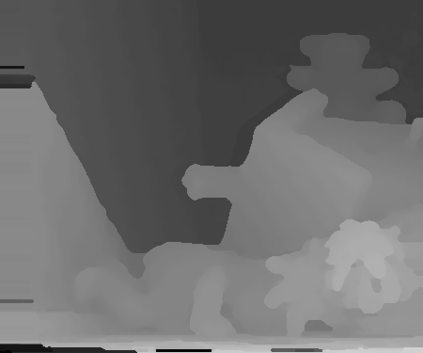
Segment-Based Plane Fitting (Results)

Slide 35
End-to-end Learning

Slide 36

FlowNet/DispNet (Fischer et al., ICCV’15) [13]
Key idea:
Learn a direct mapping from two color input to optical flow output by CNN.
The same applies to disparity.
The whole pipeline

Slide 37

FlowNet/DispNet
Main difficulty:
Generating training data.
The decoding part of the whole pipeline

Slide 38
As-Rigid-As-Possible Stereo under Second-Order Smoothness Priors
Chi Zhang^{1,2}, Zhiwei Li², Rui Cai², Hongyang Chao¹, Yong Rui²
¹ Sun Yat-Sen University ² Microsoft Research Asia
ECCV 2014

Slide 39
Motivation
Integrate segment-based scheme with pixel-wise 2nd-order smoothness prior.
Segment-based scheme:
Pros: robust to occlusion, good at resolving ambiguities.
Cons: need an initial depth estimation to bootstrap plane fitting, easily biased.
Pixel-wise 2nd-order smoothness:
Pros: can model arbitrarily slanted surfaces.
Cons: constraints act only locally, sometimes too flexible.

Slide 40








Formulation
To model the two aspects, we need two sets of variables.
Each SLIC segment s have a quadratic disparity surface .
captures the matching cost and region robustness.
The whole image has a pixel-wise disparity map .
captures the second-order smoothness using triplets.
The two aspects are connected by a constraint:
i.e. the surface induced disparity map should be the same as the disparity map we are directly optimizing.
(4 types of triplets)

Slide 41



Optimization
Eliminate the constraint by adding a coupling term
Relaxed energy:
When goes to , two problems are equivalent.
Optimize iteratively between the two parts.
Blue part has closed-form solution.
Green part is optimized by Nelder-Mead Search.

Slide 42

Results
3rd place on Middlebury 2.0 benchmark (evaluated as subpixel accuracy).

Slide 43



Results
3rd place on Middlebury 2.0 benchmark (evaluated as subpixel accuracy).

Slide 44
MeshStereo: A Global Stereo Model with Mesh Alignment Regularization for View Interpolation
Chi Zhang^{1,2}, Zhiwei Li², Yanhua Cheng², Rui Cai², Hongyang Chao¹, Yong Rui²
¹ Sun Yat-Sen University ² Microsoft Research Asia
ICCV 2015 (Oral)

Slide 45
Motivation
Task: generate high-quality meshes for view interpolation
Traditional pipeline:
Generate depth maps.
Generate meshes from the estimated depth maps (point clouds).
Cons: potentially useful info for step 2 could have been destroyed after step 1.
Ours:
Unify the depth map estimation and the mesh generation process.

Slide 46

Formulation
An ideal scenario:
Triangulate the input 2D image.
Assign a depth value to each vertex.
Lift the 2D mesh to 3D using the assigned depth values.
Reality:
Vertices may possess multiple depths!
Which means unknown number of variables to be optimized in advance.
Solution:
Assign a splitting property to each 2D vertex.
A 2D Triangulation

Slide 47







Formulation
Optimize a set of splitting properties (Upper-layer MRF).
Assign each 2D vertex has a splitting probability.
Capture/model the scene layout in terms of splitting properties.
Optimize a set of disparity planes (Lower layer MRF)
Assign each 2D triangle a disparity plane.
Capture/model the stereo matching problem in terms of disparities.
Connect the two MRFs by a Mesh Alignment term
Splitting properties provide guidance to lower-layer stereo matching.
Disparity planes provide hint to refine upper-layer scene layout.

Slide 48



Detailed Formulation

Slide 49
Optimization
Optimize upper- and lower-layer iteratively.
Upper-layer (scene layout) updated in closed form.
Lower-layer (disparities) optimized by ARAP (another iterative loop).

Slide 50


Results
1st place on Middlebury 3.0 benchmark. (Apr. 2015)
1st place on Middlebury 3.0 benchmark. (Apr. 2016, extended version)

Slide 51


Results
More coherent view interpolation.
VSRS (Traditional)
Ours

Slide 52


Results
More coherent view interpolation.
VSRS (Traditional)
Ours

Slide 53
Thank you!

Slide 54
Joint Multiview Segmentation and Localization of RGB-D Images using Depth-Induced Silhouette Consistency
Chi Zhang^{1,2}, Zhiwei Li², Rui Cai², Hongyang Chao¹, Yong Rui²
¹ Sun Yat-Sen University ² Microsoft Research Asia
CVPR 2016

Slide 55
Motivation
Goal:
use consumer-level RGB-D Cameras for object scanning.
Motivation:
Use silhouettes to improve pose estimation in RGB-D SLAM, which would in turn improve surface reconstruction.
However, object silhouettes are hard to obtain (requires manual labeling).
Solution:
Propose to solve silhouette estimation and pose refinement jointly.
Making the use of silhouettes very practical.

Slide 56

System Overview

Slide 57






Formulation
Optimize a set of object masks and their color models.
Require fore/background labeling to be consistent with their color models.
Enforce regular 4-neighborhood smoothness on masks.
Optimize a set of camera poses:
Pose-induced correspondences should agree on their colors and depths.
Introducing the depth-induced silhouettes constraints across views:
A foreground pixel should always warp to another foreground pixel in every view.
Constrains both segmentation and pose estimation.
Segmentation becomes multi-viewed. Poses are no longer constrained locally among neighboring views.

Slide 58


Detailed Formulation

Slide 59
Optimization
Optimize segmentation and poses iteratively.
Multi-view segmentation is solved by Graph Cut.
Poses are refined by Nonlinear Least Squares.

Slide 60






Results
Silhouettes (segmentations) generated on-the-fly.
Color
GrabCut
Ours

Slide 61






Results
More accurate reconstructed models due to better poses.
KinFu
RGB-D SLAM
Ours

Slide 62

Results

Slide 63
References
Yoon, Kuk-Jin, and In So Kweon. "Adaptive support-weight approach for correspondence search." IEEE Transactions on Pattern Analysis and Machine Intelligence 28.4 (2006): 650-656.
Rhemann, Christoph, et al. "Fast cost-volume filtering for visual correspondence and beyond." Computer Vision and Pattern Recognition (CVPR), 2011 IEEE Conference on. IEEE, 2011.
Bleyer, Michael, Christoph Rhemann, and Carsten Rother. "PatchMatch Stereo-Stereo Matching with Slanted Support Windows." BMVC. Vol. 11. 2011.
Zbontar, Jure, and Yann LeCun. "Computing the stereo matching cost with a convolutional neural network." Proceedings of the IEEE Conference on Computer Vision and Pattern Recognition. 2015.
Boykov, Yuri, Olga Veksler, and Ramin Zabih. "Fast approximate energy minimization via graph cuts." IEEE Transactions on pattern analysis and machine intelligence 23.11 (2001): 1222-1239.
Sun, Jian, Nan-Ning Zheng, and Heung-Yeung Shum. "Stereo matching using belief propagation." IEEE Transactions on pattern analysis and machine intelligence 25.7 (2003): 787-800.

Slide 64
References
Bobick, Aaron F., and Stephen S. Intille. "Large occlusion stereo."International Journal of Computer Vision 33.3 (1999): 181-200.
Hirschmuller, Heiko. "Accurate and efficient stereo processing by semi-global matching and mutual information." 2005 IEEE Computer Society Conference on Computer Vision and Pattern Recognition (CVPR'05). Vol. 2. IEEE, 2005.
Woodford, Oliver, et al. "Global stereo reconstruction under second-order smoothness priors." IEEE transactions on pattern analysis and machine intelligence 31.12 (2009): 2115-2128.
Kolmogorov, Vladimir, and Carsten Rother. "Minimizing nonsubmodular functions with graph cuts-a review." IEEE transactions on pattern analysis and machine intelligence 29.7 (2007): 1274-1279.
Olsson, Carl, Johannes Ulén, and Yuri Boykov. "In defense of 3d-label stereo." Proceedings of the IEEE Conference on Computer Vision and Pattern Recognition. 2013.
Klaus, Andreas, Mario Sormann, and Konrad Karner. "Segment-based stereo matching using belief propagation and a self-adapting dissimilarity measure."18th International Conference on Pattern Recognition (ICPR'06). Vol. 3. IEEE, 2006.

Slide 65
References
Dosovitskiy, Alexey, et al. "Flownet: Learning optical flow with convolutional networks." 2015 IEEE International Conference on Computer Vision (ICCV). IEEE, 2015.

